Slide 1
SCHOOLS RECOMMENDATION SCHEME
Steps to applying in 2022

Slide 2
STEP 1: GET STARTED
Submit UAC undergraduate application.
Go to uac.edu.au > ‘Apply or log in’.
Select ‘Schools Recommendation Schemes’ from dropdown menu.

Slide 3
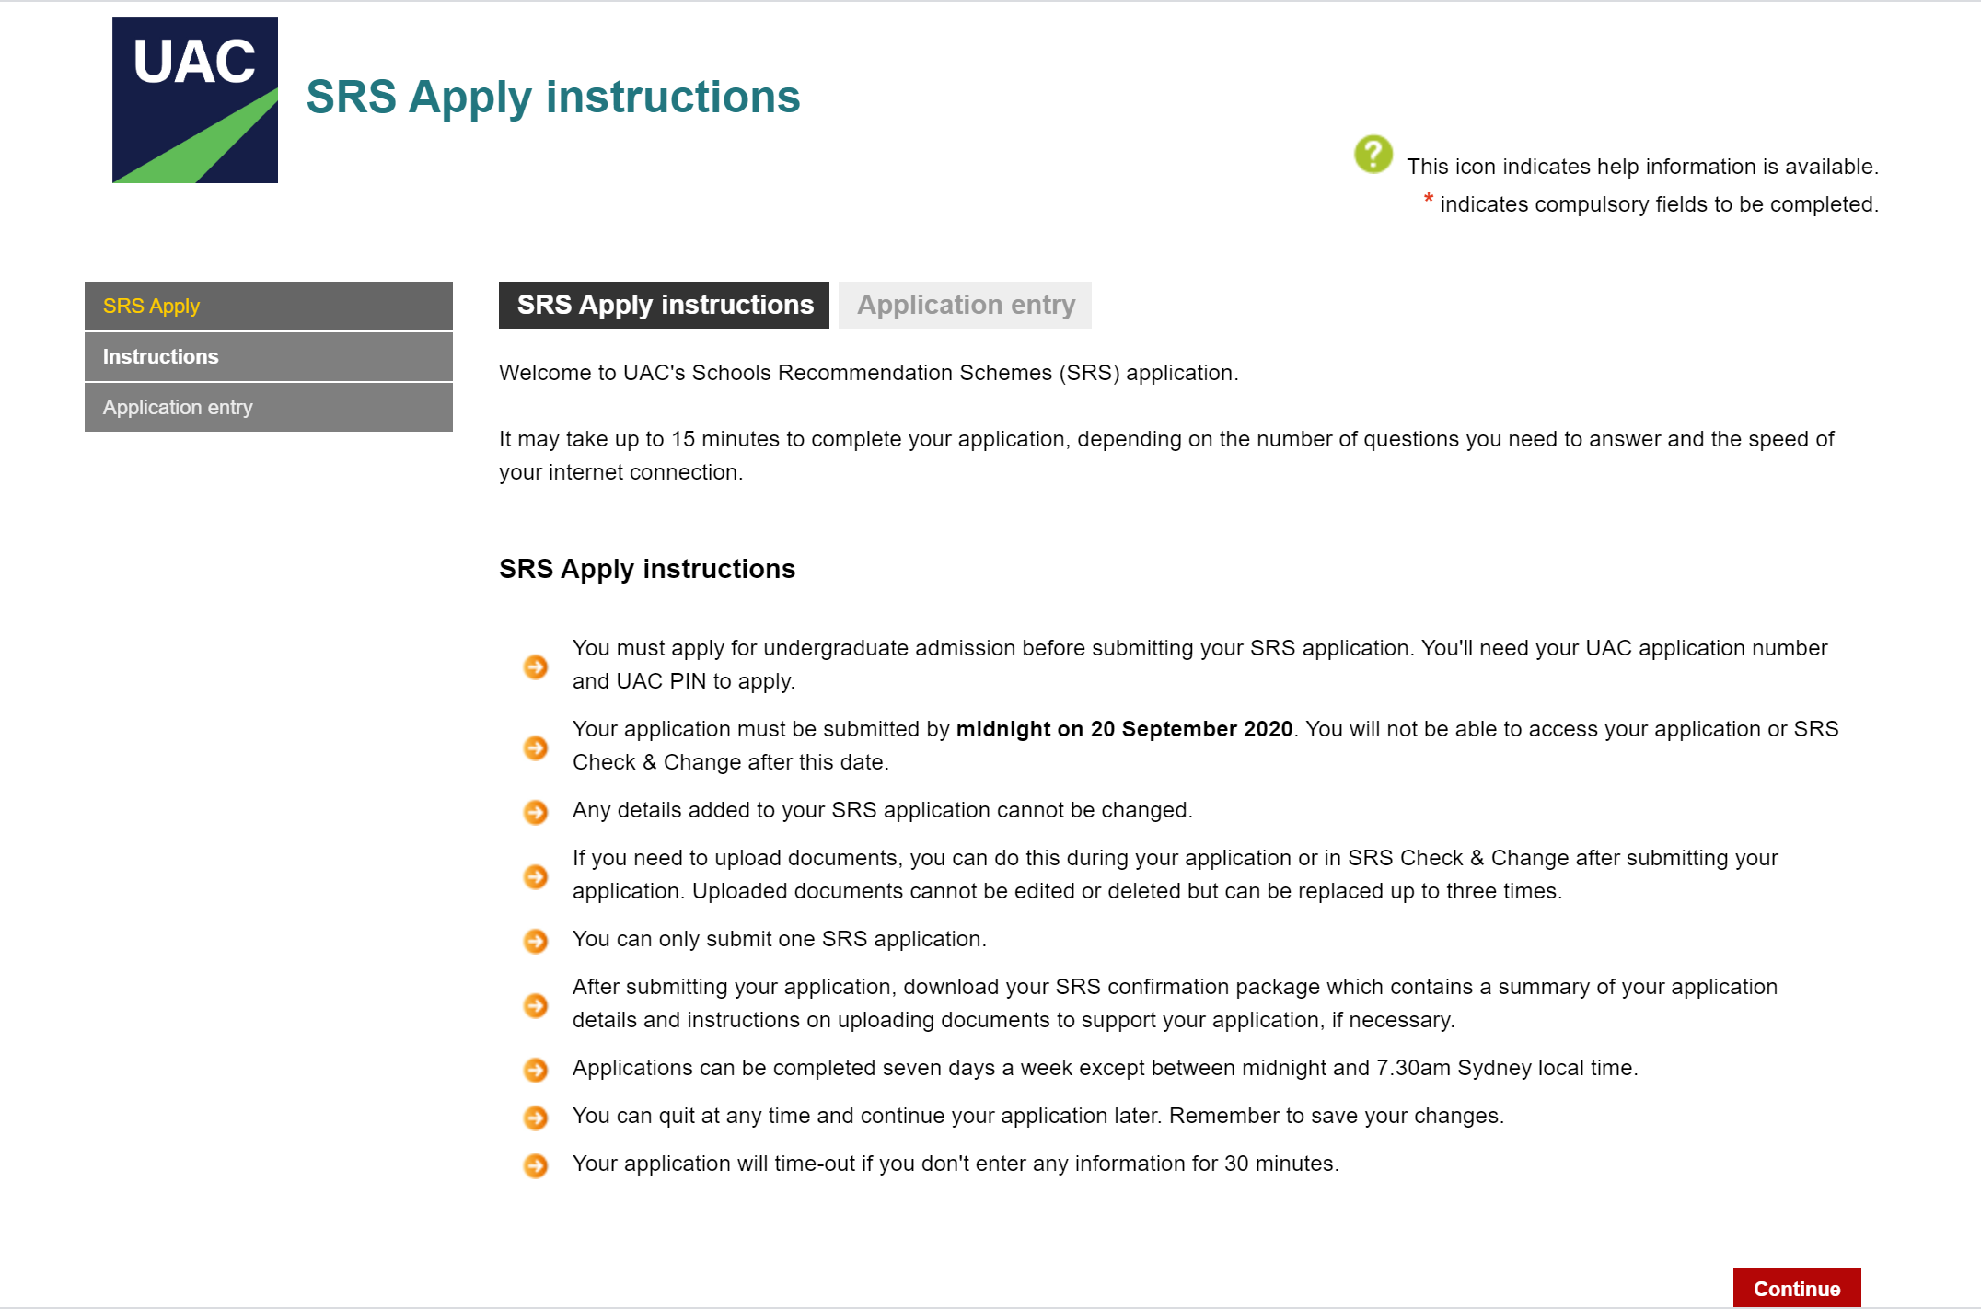
STEP 2: READ INSTRUCTIONS
Read list of instructions.
Click on ‘Continue’ to proceed.

Slide 4
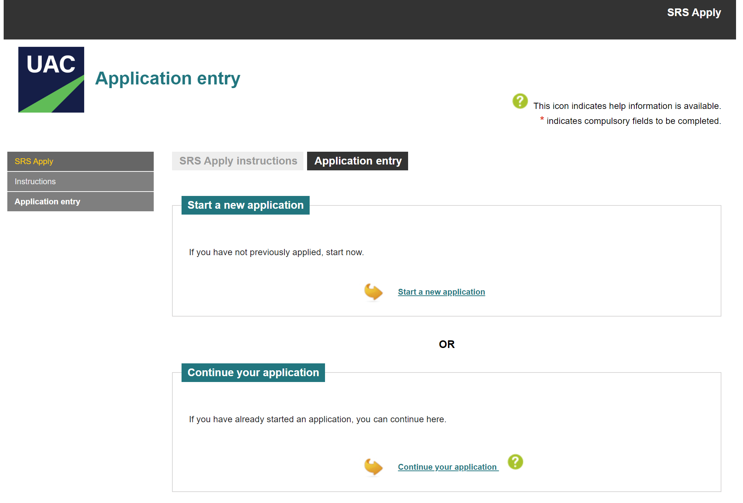
STEP 3: START NEW APPLICATION
Click on ‘Start a new application’.

Slide 5
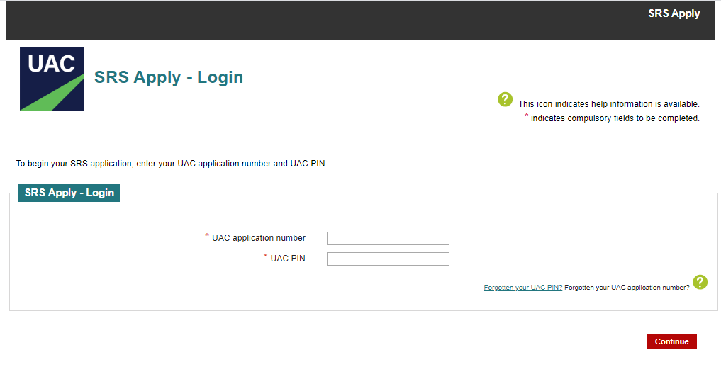
STEP 4: LOG IN
Enter UAC application number (issued when student completed undergraduate application) and UAC PIN.
If student didn’t use their NESA number and UAC PIN to apply they will not be able to proceed with their SRS application. If this is the case, please contact us.

Slide 6
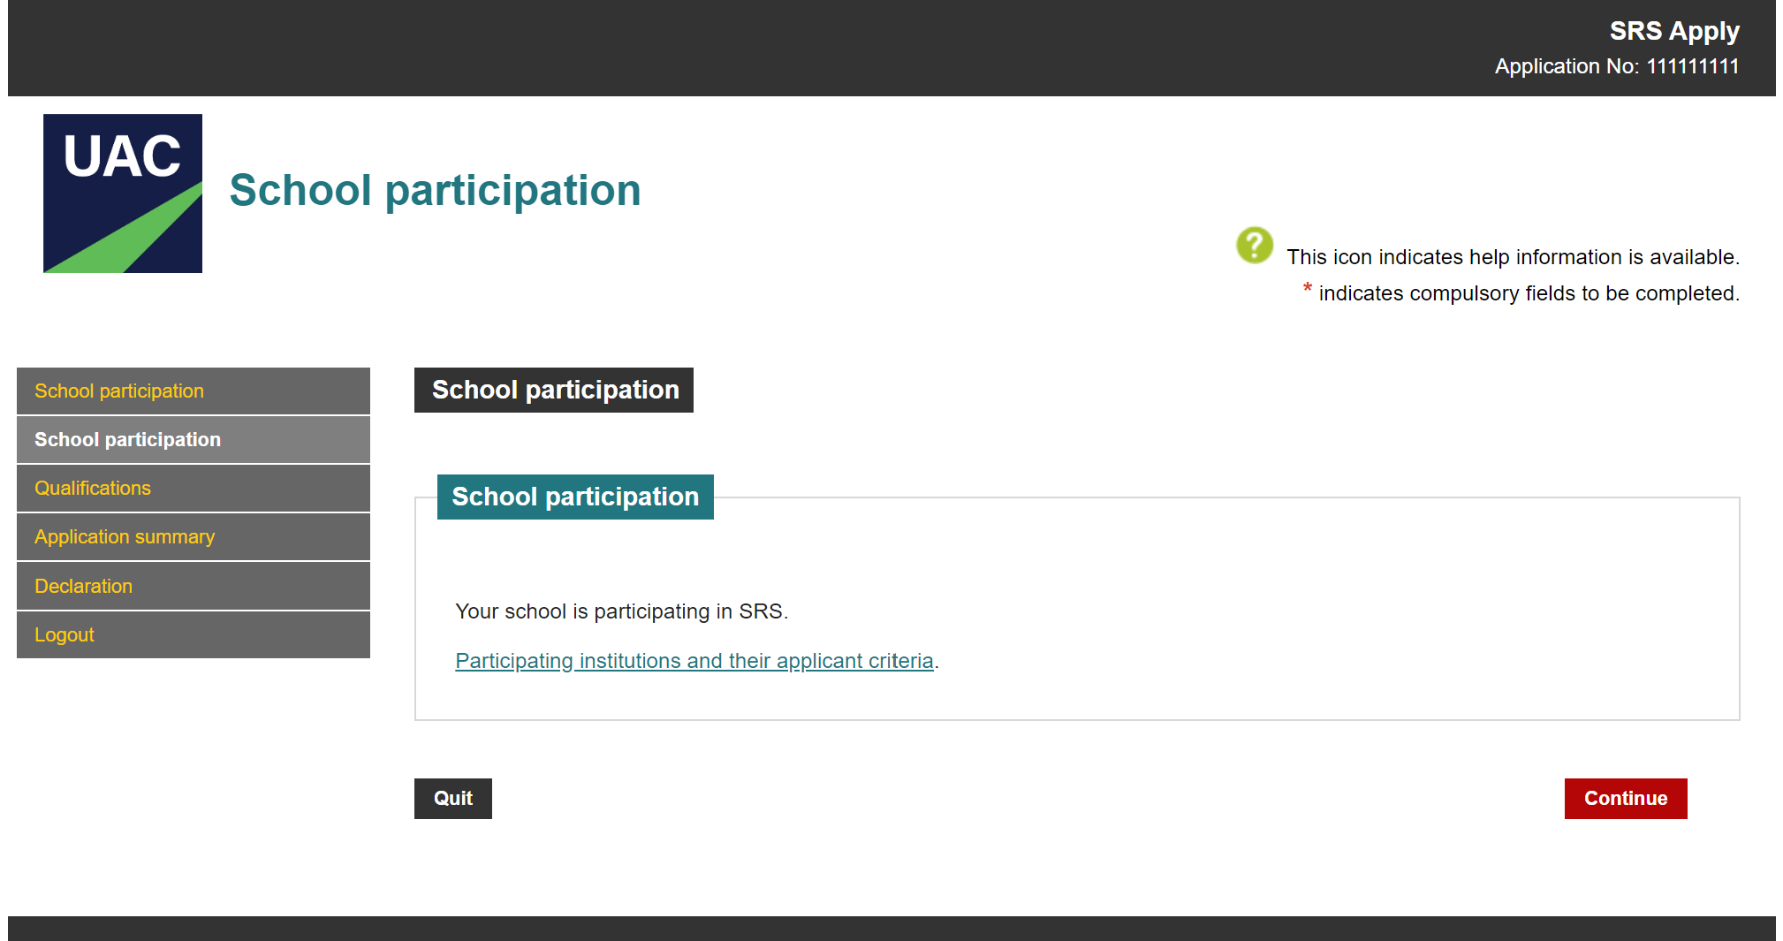
STEP 5: REVIEW INSTITUTION CRITERIA
Optional: use the link to review all the institution criteria. Better for students to do this before they apply.
Click ‘Continue’.

Slide 7
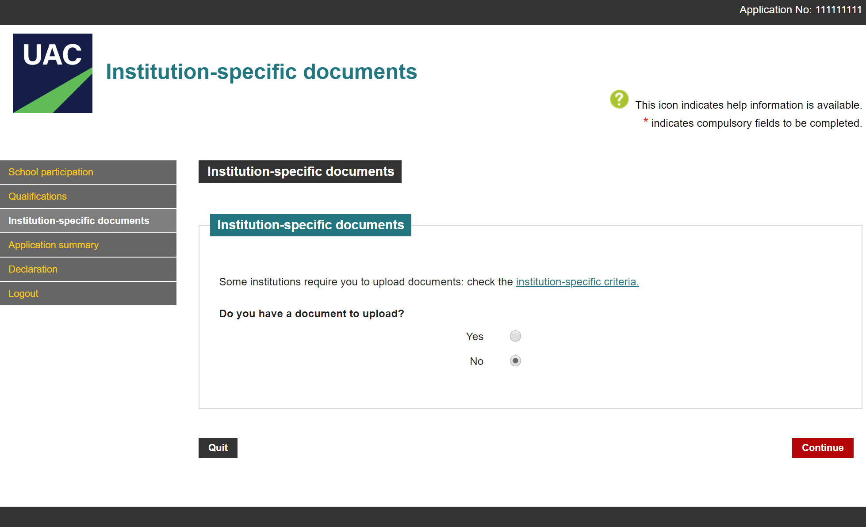
STEP 6: UPLOAD DOCUMENTS
Some institutions will need supporting documents but most do not.

Slide 8
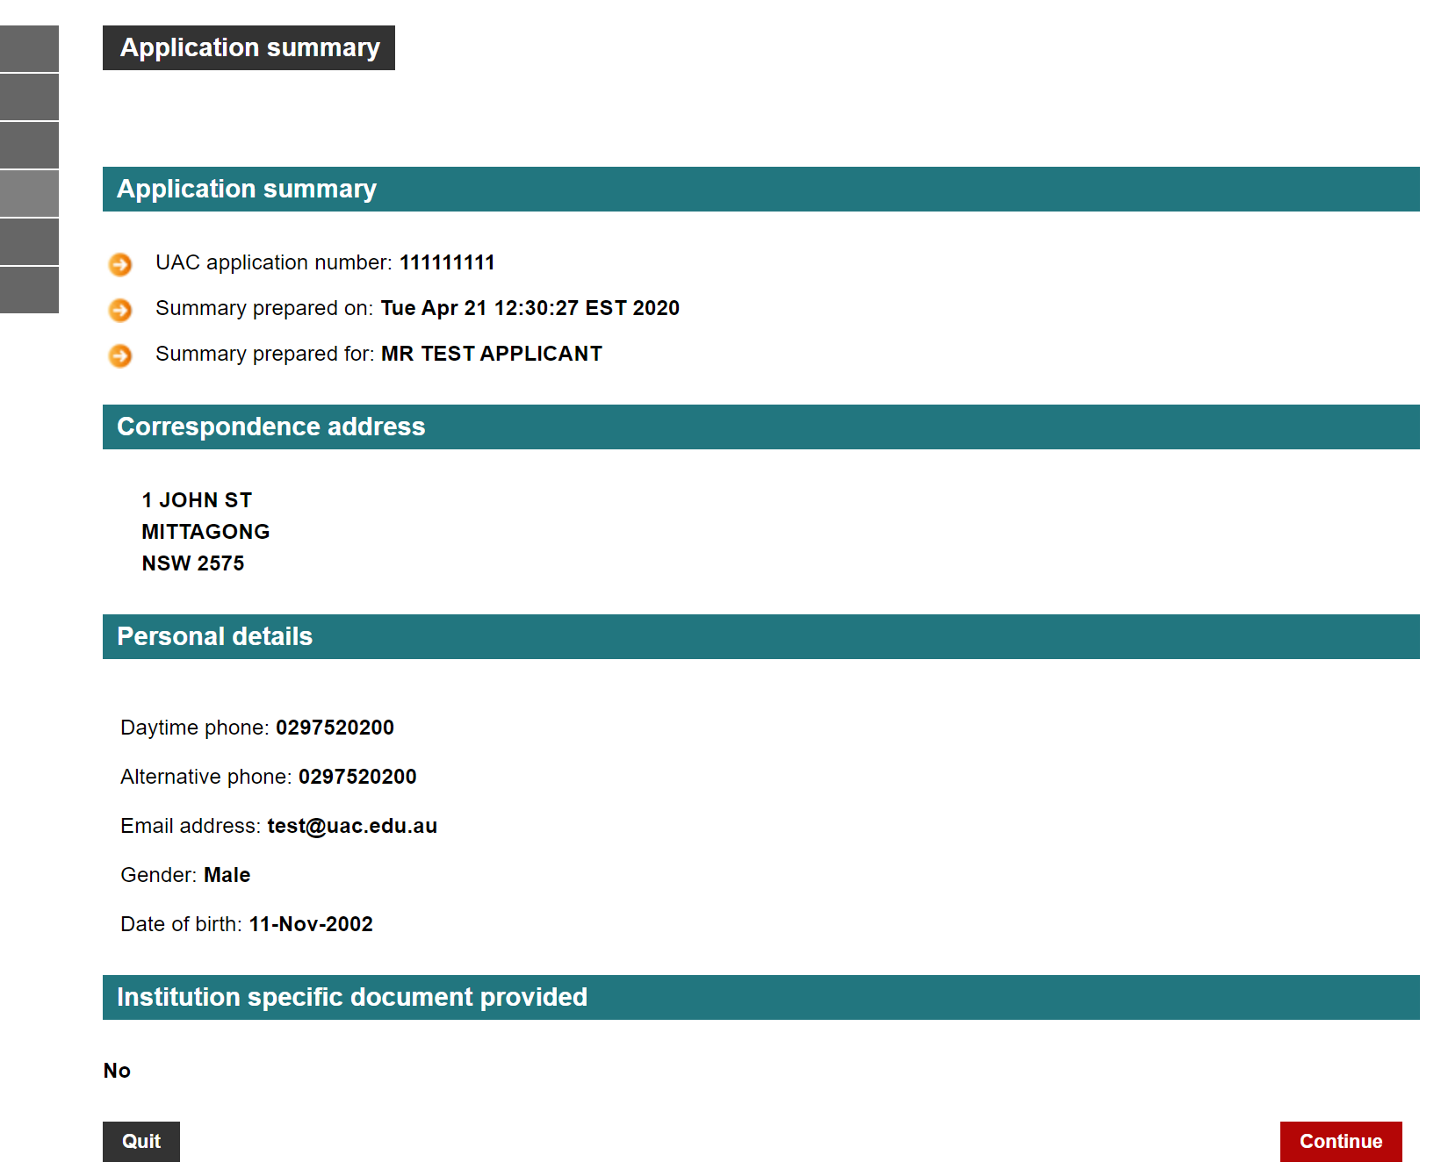
STEP 7: CHECK APPLICANT SUMMARY
Check application details.
Click ‘Continue’.

Slide 9
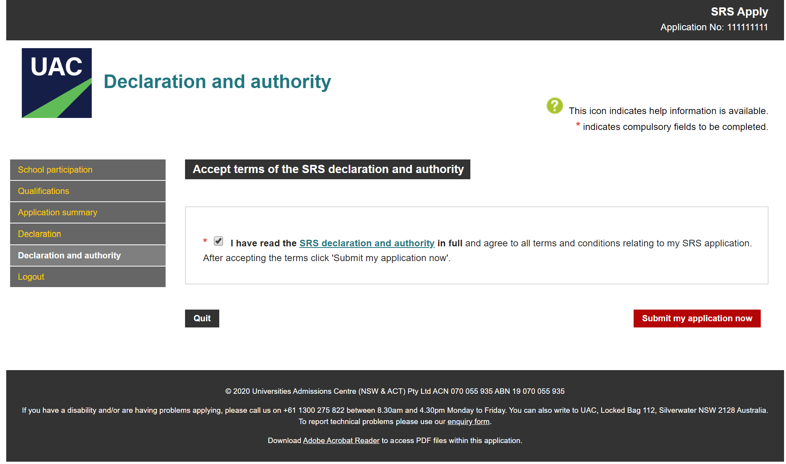
STEP 8: SUBMIT
Read the declaration and authority in full.
Accept the terms and conditions: that the information provided is true and complete and that UAC is authorised to gather information from NESA and other government bodies.
Click ‘Submit my application now’.

Slide 10
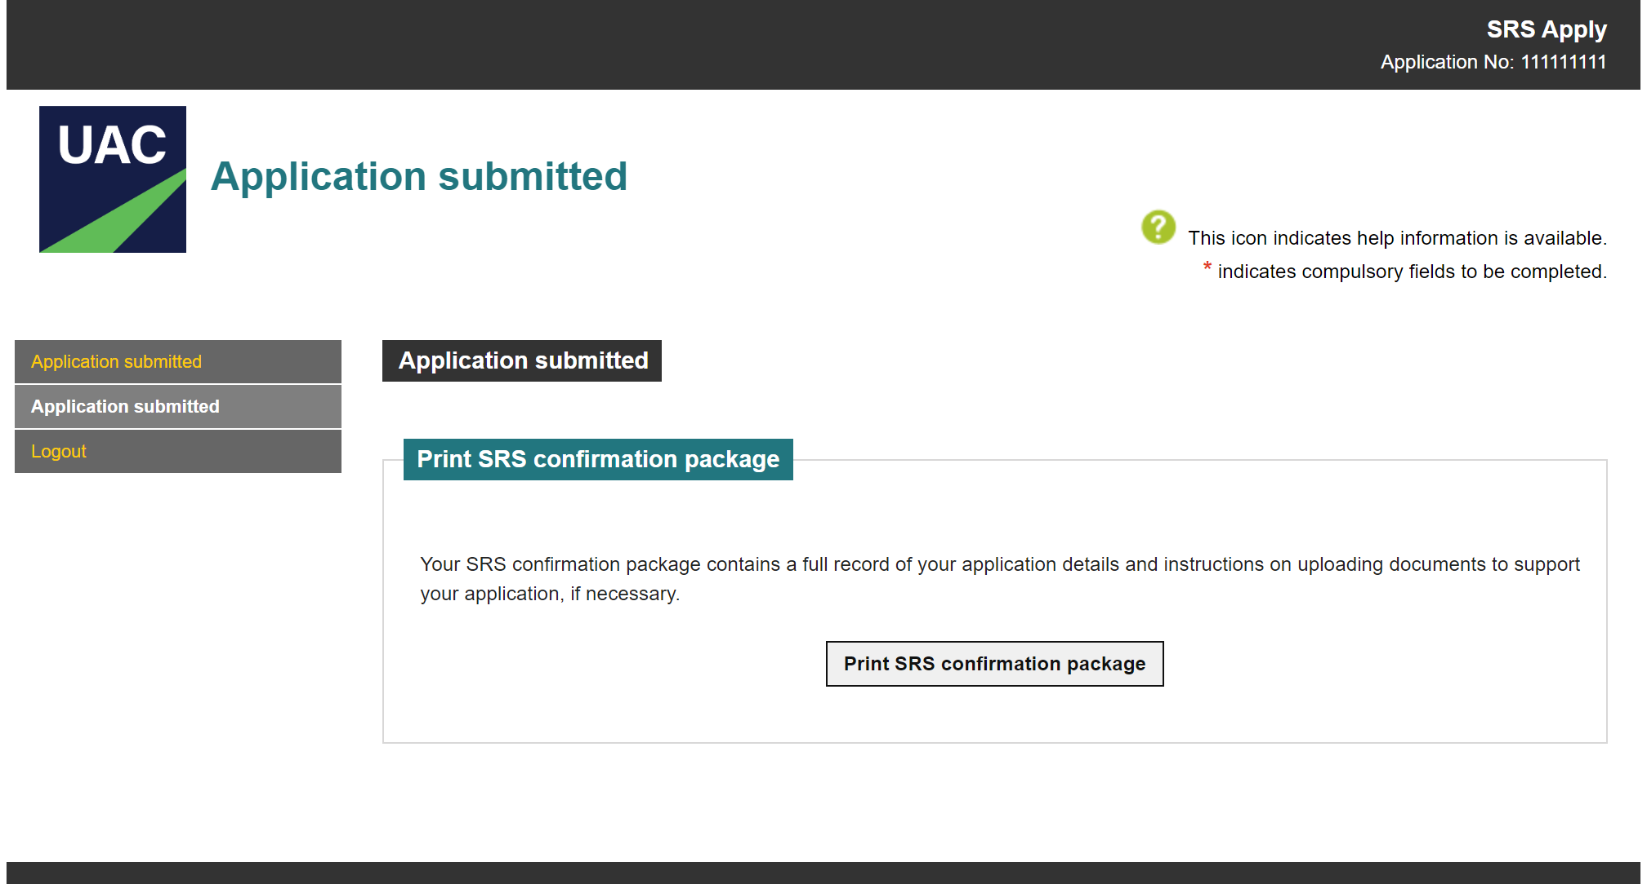
STEP 9: SAVE AND PRINT CONFIRMATION
Save and print confirmation of application.
If documents are required, log in to SRS Check & Change to upload.

Slide 11
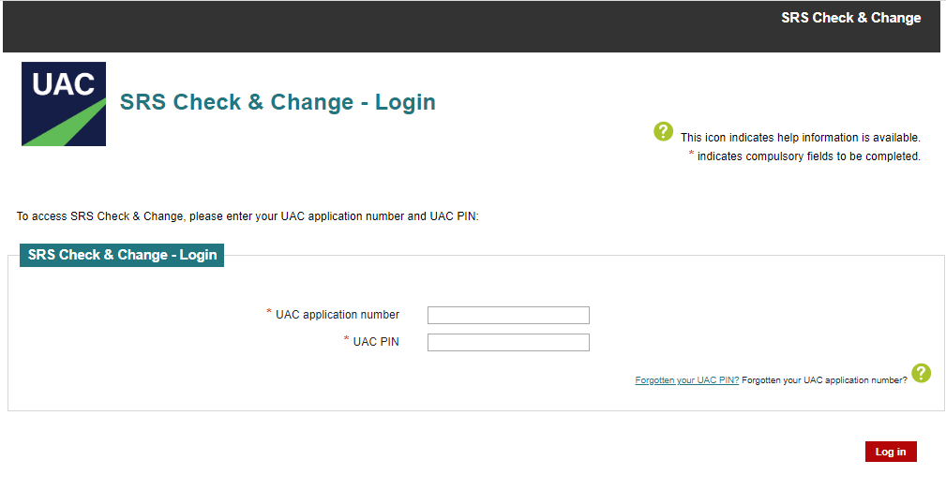
STEP 10: LOG BACK IN
If the confirmation package includes instructions to provide documents, log in to SRS Check & Change (from ‘Apply or log in’ dropdown menu) to upload.
NSW and ACT students won’t be asked to upload their Year 11 results as UAC will retrieve these from NESA or BSSS.

Slide 12
CONNECT WITH US…
Email: ce@uac.edu.au

